Slide 1
Kubernetes Hackfest
Kubernetes and Containers on Azure

Slide 2

Table of contents
Introduction
Top scenarios
Open source culture
Product deep dive
Azure Kubernetes Service Overview
Customer stories
Resources

Slide 3





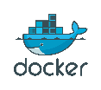
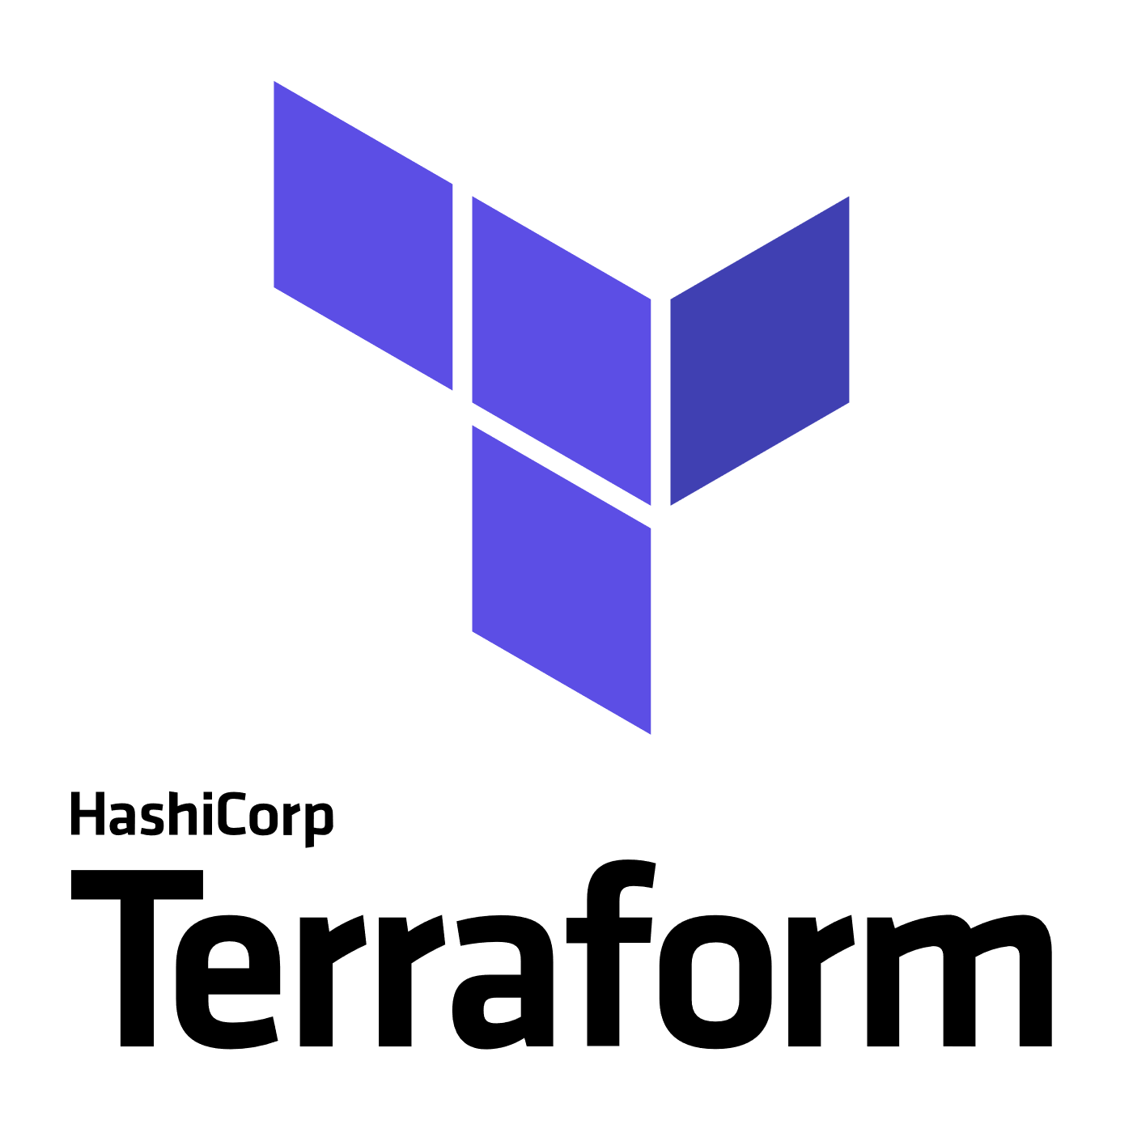


Azure + open source momentum
Azure is a strong platform for Open Source
Linux VMs are growing at ~2 times Windows VMs today
Microsoft announced GitHub acquisition
1 in 3 VMs on Azure are Linux
~60% of 3rd party Azure Marketplace images are open source
Partnerships
“Microsoft Joins Cloud Native Computing Foundation as Platinum Member”

Slide 4
Introduction
Introduction
Top scenarios
Open source culture
Product deep dive
Azure Kubernetes Service Overview
Customer stories
Resources

Slide 5
What is a container?
Containers = operating system virtualization
Traditional virtual machines = hardware virtualization
OS
Application
VM
VM
VM
Applications
Container
Container
Container
App
App
App
Kernel
OS
OS
OS
OS
Hardware
Hardware

Slide 6
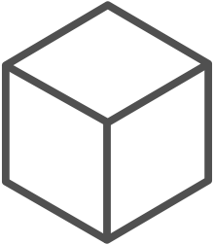
The container advantage
Fast iteration
Agile delivery
Immutability
Cost savings
Efficient deployment
Elastic bursting
For developers
For IT

Slide 7
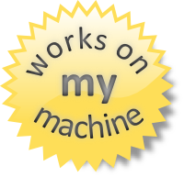
Why containers?
Repeatable execution
immutable environment
reusable and portable code (“Build, Ship, and Run”)
Consistency across development, test, & production
Fast & agile app deployment; instant startup
Cloud portability
Density, partitioning, scale
Diverse developer framework support
Promotes microservices

Slide 8
The elements of orchestration
Scheduling
Affinity/anti-affinity
Health monitoring
Failover
Scaling
Networking
Service discovery
Coordinated app upgrades

Slide 9


Containers and Kubernetes momentum
“By 2020, more than 50% of enterprises will run mission-critical, containerized cloud-native applications in production.”
Half of container environment is orchestrated.¹
77%
77% of companies² who use container orchestrators choose Kubernetes.
The average size of a container deployment has grown 75% in one year. ¹
Larger companies are leading the adoption.¹
75%
50%
Nearly 50% of organizations¹ running 1000 or more hosts have adopted containers.
¹ Datadog report: 8 Surprising Facts About Real Docker Adoption
² CNCF survey: cloud-native-technologies-scaling-production-applications

Slide 10
Kubernetes: the industry leading orchestrator
Portable
Public, private, hybrid, multi-cloud
Extensible
Modular, pluggable, hookable, composable
Self-healing
Auto-placement, auto-restart, auto-replication, auto-scaling

Slide 11
Kubernetes 101
Internet
Kubernetes control
Worker node
Kubernetes users communicate with API server and apply desired state
kubelet
kube-proxy
Master node
Docker
Master nodes actively enforce desired state on worker nodes
Prod
Prod
API server
Containers
Containers
Worker nodes support communication between containers
-controller-manager
-scheduler
Worker node
kubelet
kube-proxy
Worker nodes support communication from the Internet
replication, namespace, serviceaccounts, etc.
etcd
Docker
Prod
Prod
Containers
Containers

Slide 12
How managed Kubernetes on Azure works
Automated upgrades, patches
High reliability, availability
Easy, secure cluster scaling
Self-healing
API server monitoring
At no charge
Azure managed control plane
App/ workload definition
Self-managed master node(s)
Kubernetes API endpoint
etcd Store
User
API server
Scheduler
Controller Manager
Cloud Controller
Schedule pods over private tunnel
Customer VMs
Docker
Docker
Docker
Docker
Docker
Pods
Pods
Pods
Pods
Pods

Slide 13
From infrastructure to innovation
Managed Kubernetes empowers you to do more
Focus on your containers and code, not the plumbing of them
Responsibilities | DIY with Kubernetes | Managed Kubernetes on Azure
Containerization
Application iteration, debugging
CI/CD
Cluster hosting
Cluster upgrade
Patching
Scaling
Monitoring and logging
Customer
Microsoft

Slide 14
Azure Kubernetes momentum
10x
5x
Last 12 months
Kubernetes on Azure usage grew 10x
Kubernetes on Azure customers grew 5x

Slide 15
Azure Kubernetes Service Overview
Introduction
Top scenarios
Open source culture
Product deep dive
Azure Kubernetes Service Overview
Customer stories
Resources

Slide 16
AKS: Simplify the deployment, management, and operations of Kubernetes
Deploy and manage Kubernetes with ease
Accelerate containerized application development
Set up CI/CD in a few clicks
Secure your Kubernetes environment
Scale and run applications with confidence
Work how you want with open-source tools & APIs

Slide 17
Azure Kubernetes Service (AKS) Kubernetes made easy – get the most complete and simple end-to-end experience for seamless Kubernetes lifecycle management on Azure
Deploy and manage Kubernetes with ease Free managed control plane for auto upgrades, patching and self healing Provision with portal, CLI, ARM, or Terraform Full visibility with integrated monitoring and logging | Scale and run applications with confidence Built-in auto scaling Global data center to boost performance and reach Elastically burst from AKS cluster using ACI | Secure your Kubernetes environment Control access through AAD and RBAC Safeguard keys and secrets with Key Vault Secure network communication with VNET and CNI
Accelerate containerized application development Define, install and upgrade apps easily with Helm Automatically scaffold, containerize and deploy with CLI or Visual Studio Rapidly iterate, test and debug microservices using Dev Spaces | Work how you want with open-source tools & APIs 100% open source Kubernetes Take full advantage of services and tools in the ecosystem Easily integrate with SLA-backed Azure services with OSBA | Set up CI/CD in a few clicks Three steps away from a CI/CD pipeline with DevOps Project Work with existing tools such as Jenkins Geo-replicated container registry

Slide 18


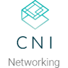



















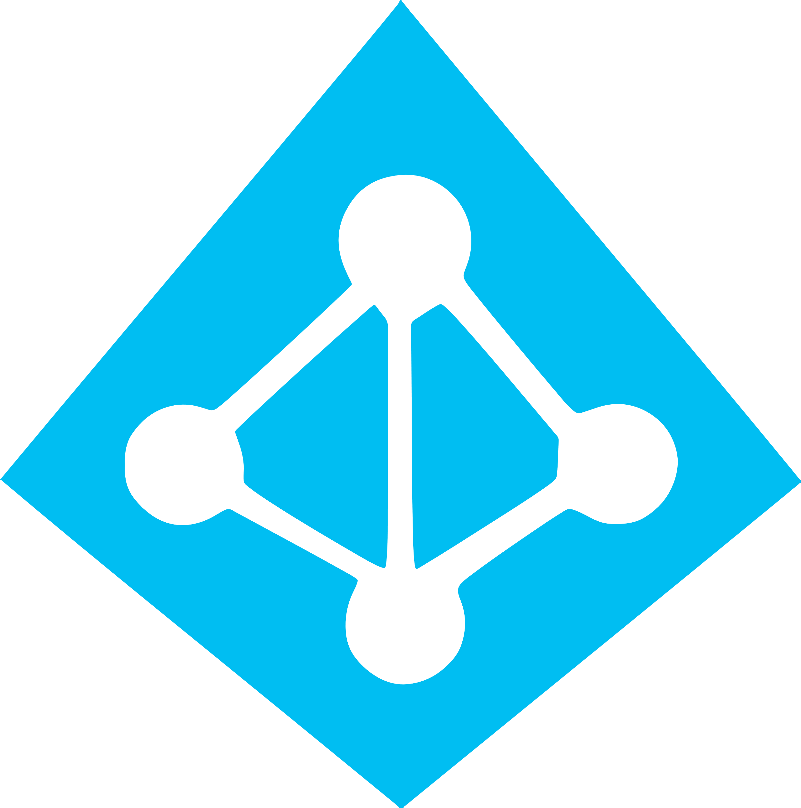


Work how you want with opensource tools and APIs
 | Development | DevOps | Monitoring | Networking | Storage | Security
Take advantage of services and tools in the Kubernetes ecosystem
OR, Leverage growing Azure support
RBAC
Azure Container Registry
AAD
Key Vault
VSTS
ARM
VS Code
Azure Monitor
Azure VNET
Azure Storage

Slide 19
Azure makes Kubernetes easy
Deploy and manage Kubernetes with ease
Task | The Old Way | With Azure
Create a cluster | Provision network and VMs Install dozens of system components including etcd Create and install certificates Register agent nodes with control plane | az aks create
Upgrade a cluster | Upgrade your master nodes Cordon/drain and upgrade worker nodes individually | az aks upgrade
Scale a cluster | Provision new VMs Install system components Register nodes with API server | az aks scale

Slide 20
Azure makes Kubernetes easy
Accelerate containerized application development
Task | The Old Way | With Azure
Build a containerized app and deploy to Kubernetes | Build the app Write a Dockerfile Build the container image Push the container to a registry Write Kubernetes manifests/Helm chart Deploy to Kubernetes | draft init to configure your environment draft create to auto-create Dockerfile/Helm chart draft up to deploy to Kubernetes
Build a containerized app and deploy to Kubernetes | Set up a local dev environment using Minikube Determine the transitive closure of your dependencies Identify behavior of dependencies for key test cases Stub out dependent services with expected behavior Make local changes, check-in, and hope things work Validate with application logs | Use DevSpaces Do breakpoint debugging in your IDE
Expose web apps to the internet with a DNS entry | Deploy an ingress controller Create a load-balanced IP for it Add an ingress resource to your deployment Acquire a custom domain Create a DNS A-record for your service | Turn HTTP application routing on in your cluster Add an ingress resource to your deployment

Slide 21
Azure makes Kubernetes easy
Set up CI/CD in a few clicks
Task | The Old Way | With Azure
Set up a CI/CD pipeline and deploy to Kubernetes | Create git repo Create a build pipeline Create a container registry Create a Kubernetes cluster Configure build pipeline to push to container registry Configure build pipeline to deploy to Kubernetes | Create an Azure DevOps project with AKS as a target
Make container images available for deployment worldwide | Create a container registry in every region Configure build pipeline with multiple endpoints Loop through all regions and push following build | Create an Azure Container Registry with geo-replication Push your image to a single endpoint
Track health with consolidated cluster and application logs | Choose a logging solution Deploy log stack in your cluster or provision a service Configure and deploy a logging agent onto all nodes | Checkbox “container monitoring” in the Azure portal

Slide 22
Secure your Kubernetes environment
Control access through AAD and RBAC
Safeguard keys and secrets with Key Vault
Secure network communications with VNET and CNI
Compliant Kubernetes service with certifications covering SOC, HIPAA, and PCI

Slide 23
Scale and run applications with confidence
Built-in auto scaling
Global data center to boost performance and reach
Elastically burst from AKS cluster using ACI
Geo-replicated container registry

Slide 24
Top scenarios
Introduction
Top scenarios
Open source culture
Product deep dive
Azure Kubernetes Service Overview
Customer stories
Resources

Slide 25
Top scenarios for Kubernetes on Azure
Lift and shift to containers
Microservices
Machine learning
IoT
Cost saving
without refactoring your app
Agility
Faster application development
Performance
Low latency processing
Portability
Build once, run anywhere

Slide 26

Lift and shift to containers
Microservices
Machine learning
IoT
App modernization without code changes
Speed application deployments by using container technology
Defend against infrastructure failures with container orchestration
Increase agility with continuous integration and continuous delivery
Azure Container Registry
Kubernetes cluster
Existing application
CI/CD
Modernized application
Modernized application
Modernized application
Cloud Database

Slide 27

Lift and shift to containers
Microservices
Machine learning
IoT
Capabilities
Use Azure Container Registry to store container images for your modernized applications, replicated globally with ACR geo-replication
Integrate AKS with Azure Pipelines to enable continuous integration/continuous delivery (CI/CD) using Helm or other Kubernetes ecosystem tooling
Enhance security with Azure Active Directory and RBAC to control access to AKS resources
Easily access to SLA-backed Azure Services such as Azure Database for MySQL using Open Service Broker for Azure (OSBA)
Virtual network
Active Directory
Azure Container Registry
Existing application
Azure Pipelines
Database for MySQL
AKS
OSBA

Slide 28
Lift and shift to containers
Microservices
Machine learning
IoT
Microservices: for faster app development
Monolithic
Microservices
Independent deployments
Improved scale and resource utilization per service
Smaller, focused teams
Large, all-inclusive app
Small, independent services
App
App
App

Slide 29




Lift and shift to containers
Microservices
Machine learning
IoT
Capabilities
Helm chart
Use Azure Dev Spaces to iteratively develop, test, and debug microservices targeted for AKS clusters.
Azure DevOps has native integration with Helm and helps simplifying continuous integration/continuous delivery (CI/CD)
Virtual node—a Virtual Kubelet implementation—allows fast scaling of services for unpredictable traffic using ACI.
Azure Monitor provides a single pane of glass for monitoring over app telemetry, cluster-to-container level health analytics.
4
Inner loop
Azure Container Registry
AKS production cluster
Source code control
Azure Monitor
Pods
Azure DevSpaces
AKS dev cluster
Test
Debug
1
Auto-build
Azure Pipeline/ DevOps Project
2
3
ACI instances
Pods
CI/CD
https://github.com/Microsoft/SmartHotel360-AKS-DevSpaces-Demo

Slide 30
Lift and shift to containers
Microservices
Machine learning
IoT
Data science in a box
Algorithm
Quick deployment and high availability
Low latency data processing
Consistent environment across test, control and production
GPU-enabled VMs
Training data
AKS trained model
AI model in production
Serve the model
Data Scientist
https://github.com/Azure/kubeflow-labs
Compute
Developer
<\>

Slide 31

Lift and shift to containers
Microservices
Machine learning
IoT
App developer
Capabilities
Package ML model into a container and publish to ACR
AKS
6
Query the model for AI features in app
Azure Blob storage hosts training data sets and trained model
ML model in containers
Use Kubeflow to deploy training job to AKS, distributed training job to AKS includes Parameter servers and Worker nodes…
1
Azure Container Registry
Data scientist
3
4
Serve the model in production
Kubeflow
Parameter server nods
Worker nodes
GPU-enabled VMS
Serve production model using Kubeflow, promoting a consistent environment across test, control and production
2
Azure Blob Storage
5
AKS supports GPU enabled VM
Developer can build features querying the model running in AKS cluster
https://github.com/Azure/kubeflow-labs

Slide 32




Lift and shift to containers
Microservices
Machine learning
IoT
Scalable Internet of Things solutions
IoT Edge devices
Portable code, runs anywhere
Elastic scalability and manageability
Quick deployment and high availability
AKS
IoT Edge Connector
IoT Hub
SQL Database
Azure Cosmos DB
Database for MySQL

Slide 33
Lift and shift to containers
Microservices
Machine learning
IoT
Capabilities
Azure IoT Edge encrypts data and send to Azure, which then decrypts the data and send to storage
Decrypt
Decompress
Send to Storage
Compress
Encrypt
Send to Cloud
1
Virtual node, an implementation of Virtual Kubelet, serves as the translator between cloud and edge
Azure
Azure IoT Edge
Kubernetes cluster
2
4
IoT Edge Provider in virtual node redirects containers to IoT Edge and extend AKS cluster to target millions of Edge devices
Node
Node
Virtual node
Docker container
Docker container
Docker container
Docker container
Docker container
3
Docker containers
IoT Edge Provider
Consistent update, manage, and monitoring as one unit in AKS using single pod definition

Slide 34
Product deep dive
Introduction
Top scenarios
Open source culture
Product deep dive
Azure Kubernetes Service Overview
Customer stories
Resources

Slide 35
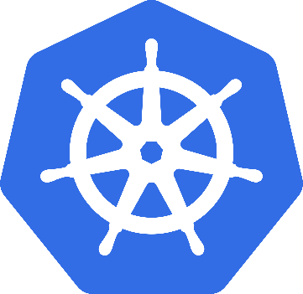
What is Kubernetes?
Background
"Kubernetes is an open-source system for automating deployment, scaling, and management of containerized applications”
Schedules and runs application containers across a cluster of machines
Kubernetes v1.0 released on July 21, 2015. Joe Beda, Brendan Burns, & Craig McLuckie
Key features
Declarative infrastructure
Self-healing
Horizontal scaling
Automated rollouts and rollbacks
Service discovery and load balancing
Automatic bin packing
Storage orchestration
Secret and configuration management
Not a PaaS platform

Slide 36
Kubernetes 101
Internet
Kubernetes control
Worker node
Kubernetes users communicate with API server and apply desired state
kubelet
kube-proxy
Master node
Docker
Master nodes actively enforce desired state on worker nodes
Prod
Prod
API server
Containers
Containers
Worker nodes support communication between containers
-controller-manager
-scheduler
Worker node
kubelet
kube-proxy
Worker nodes support communication from the Internet
replication, namespace, serviceaccounts, etc.
etcd
Docker
Prod
Prod
Containers
Containers

Slide 37
pod
deployment
Kubernetes Resources
service
Replica set
ingress
Daemon set
job
namespace
Secret
Config-map

Slide 38
Azure Container Registry – vulnerability scanning
Developer/CI system builds container image
1
Image pushed to Azure Container Registry
Container image
Developer
Azure Container Registry
4
2
Fails
Aqua and Twistlock container security
Azure Container Registry quarantines image until scanning passes
3
Passes
5
Azure Container Registry scans content leveraging Aqua, Twistlock
Repository
Azure Container Registry publishes the image to the repository

Slide 39
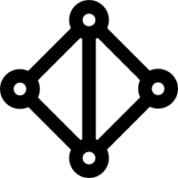
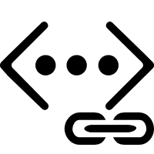
Secure network communications with VNET and CNI
Uses Azure subnet for both your containers and cluster VMs
1
Azure VNet A
Allows for connectivity to existing Azure services in the same VNET
Backend services subnet
AKS subnet
Use Express Route to connect to on-premises infrastructure VNET peering to other VNET
AKS cluster
SQL Server
On-premises infrastructure
Enterprise system
2
Azure Express Route
2
AKS VNet integration works seamlessly with your existing network infrastructure
VNet peering
VNet B
Other peered VNets
3

Slide 40
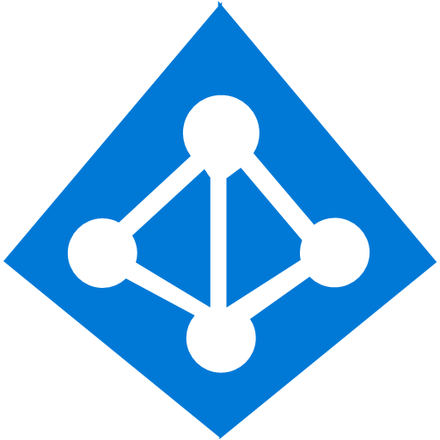
Identity and access management through AAD and RBAC
The client application authenticates to the AAD token issuance endpoint and requests an access token
Azure Active Directory
The AAD token issuance endpoint issues the access token
1
The access token is used to authenticate to the secured resource
Client application
Token
2
AKS
Data from the secured resource is returned to the web application
3
Token
Azure delivers a streamlined identity and access management solution with Azure Active Directory (AAD) and Azure Kubernetes Services (AKS)
4

Slide 41
Pod identity
Kubernetes operator defines an identity map for K8s service accounts
Developer
<\>
Node Managed Identity (NMI) watches for mapping reaction and syncs to Managed Service Identify (MSI)
3
Kubernetes
Kubernetes controller
Azure Identity Binding
Azure SQL Server
1
Pod
Developer creates a pod with a service account, and pod uses standard Azure SDK to fetch a token bound to MSI
Active Directory Pod Identity
Token
Azure MSI
Pod uses access token to consume other Azure services; services validate token
4
NMI + EMSI
2

Slide 42
AKS Engine
AKS engine takes the best practices developed for AKS and provides it as an OSS project for deploying unmanaged clusters.
Build fully customized Kubernetes clusters
Easily deploy Kubernetes on Azure Stack
aks-engine cluster definition file
Generate template using aks-engine
ARM template file
Deployed Cluster on Azure
Deploy ARM template using Azure CLI

Slide 43
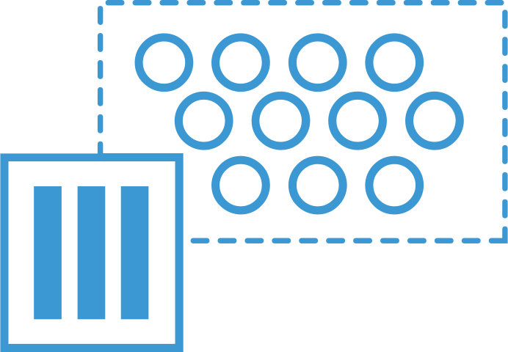
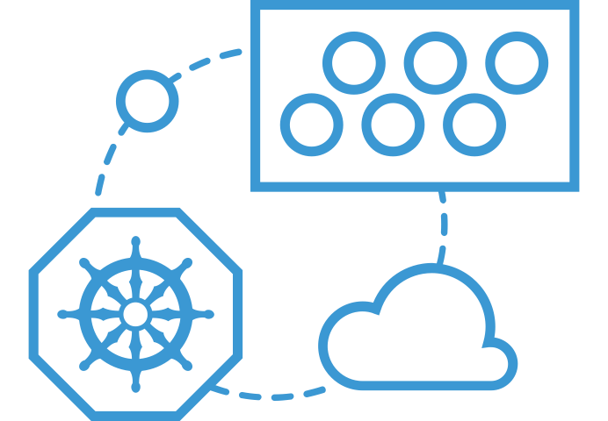
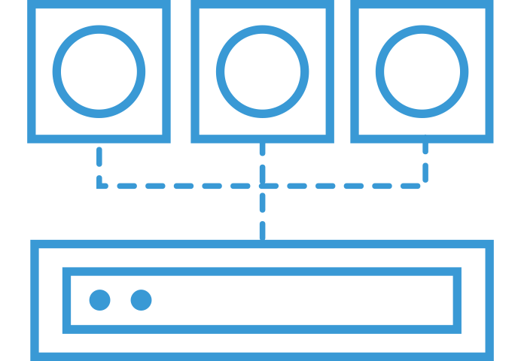

Azure Container Instances (ACI)
ACS Engine
Easily run containers on Azure without managing servers
Azure Container Instances (ACI)
Azure Container Registry (ACR)
Open Service Broker API (OSBA)
Run containers without managing servers
Increase agility with containers on demand
Secure applications with hypervisor isolation
Release Automation Tools

Slide 44
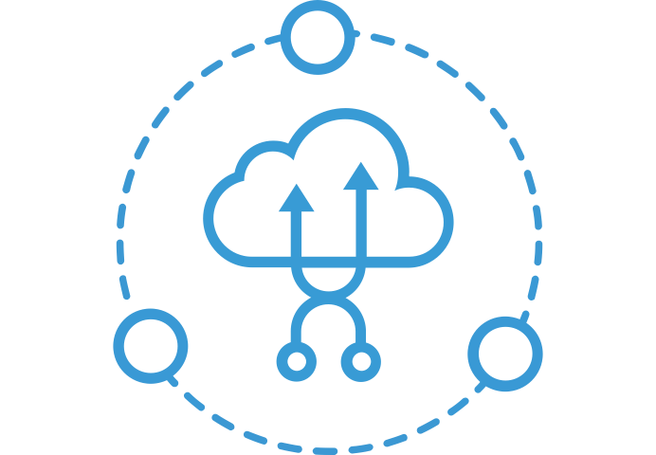
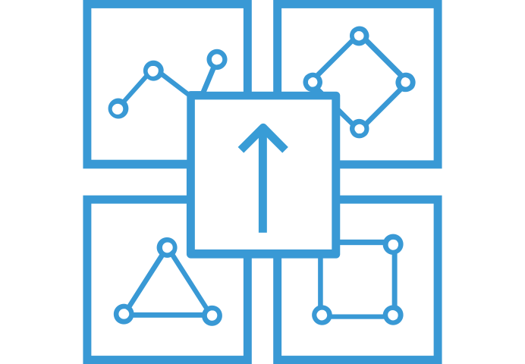
What can you build with ACI
ACS Engine
Azure Container Instances (ACI)
Azure Container Service (AKS) can use the Virtual Kubelet to provision pods inside ACI that start in seconds. Then ACI provides fast, isolated compute to meet traffic that comes in spikes, without the need to manage servers.
Combine ACI with the ACI Logic Apps connector, Azure queues, and Azure Functions to build robust infrastructure that can elastically scale out containers on demand.
Use Azure Container Instances for data processing where source data is ingested, processed, and placed in a durable store such as Azure Blob storage. Achieve significant cost savings through per-second billing.
Elastic bursting with AKS
Azure Container Registry (ACR)
Open Service Broker API (OSBA)
Event-driven applications with Azure Logic Apps
Release Automation Tools
Data processing jobs

Slide 45
Azure Container Instances (ACI)
ACS Engine
Get started easily
Azure Container Instances (ACI)
$ az container create --name mycontainer --image microsoft/aci-helloworld --resource-group myResourceGroup --ip-address public
"ipAddress": {
"ip": "52.168.86.133",
"ports": [...]
},
"location": "eastus",
"name": "mycontainer",
"osType": "Linux",
"provisioningState": "Succeeded",
$ curl 52.168.86.133
<html>
<head>
<title>Welcome to Azure Container Instances!</title>
</head>
Azure Container Registry (ACR)
Open Service Broker API (OSBA)
Release Automation Tools

Slide 46
Azure Container Instances (ACI)
ACS Engine
Bursting with Azure Virtual Nodes
PREVIEW
Azure Container Instances (ACI)
VM
VM
Pod
Waste
Pod
Pod
Pod
Waste
Pod
Pod
Pod
Pod
Azure Container Registry (ACR)
Azure Container Instances (ACI)
Pod
Pod
Pod
Pod
Pod
Application architect
Kubernetes control plane
Virtual Node
Pod
Pod
Pod
Pod
Pod
Pod
Pod
Pod
Pod
Pod
Open Service Broker API (OSBA)
Pod
Pod
Pod
Pod
Pod
Deployment/ tasks
Pod
Pod
Pod
Pod
Pod
Infrastructure architect
Release Automation Tools
Pod
Waste
Pod
Pod
Pod
Waste
Pod
Pod
Pod
Pod
VM
VM

Slide 47
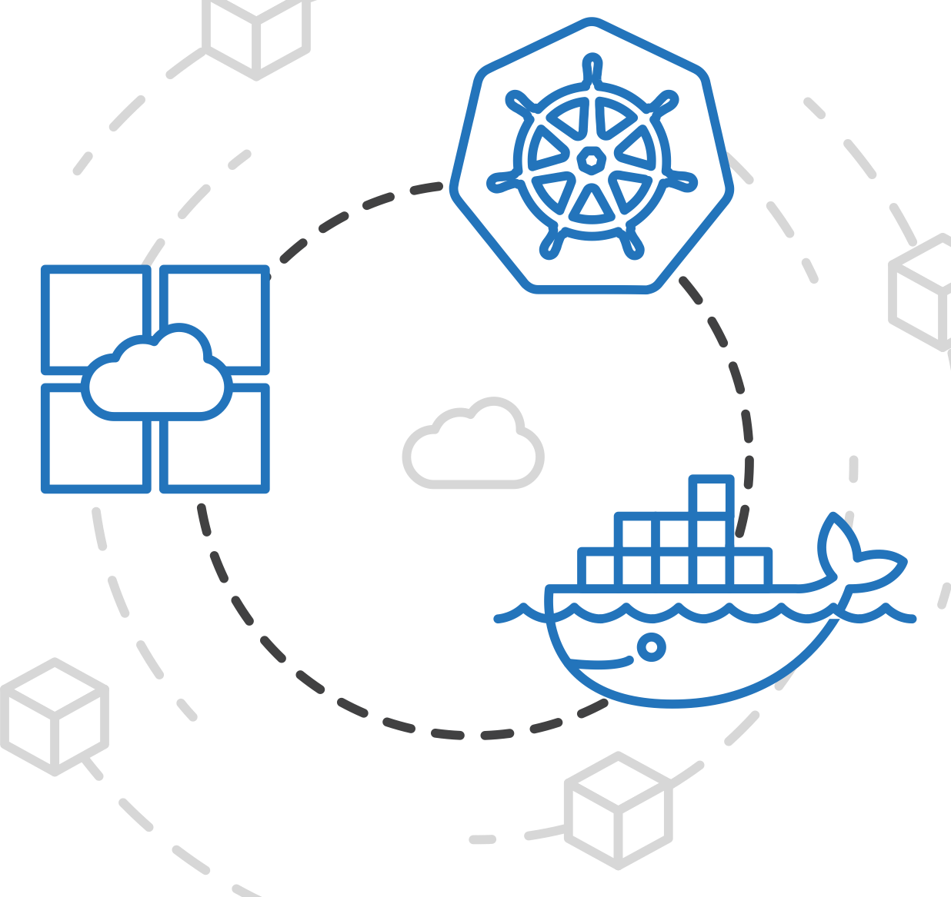
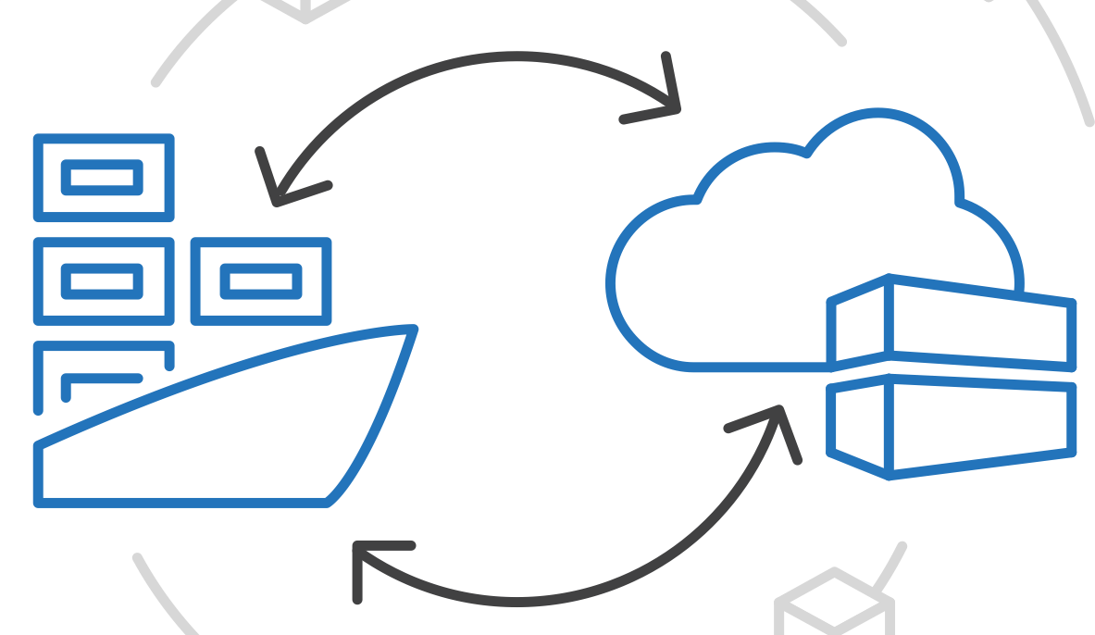
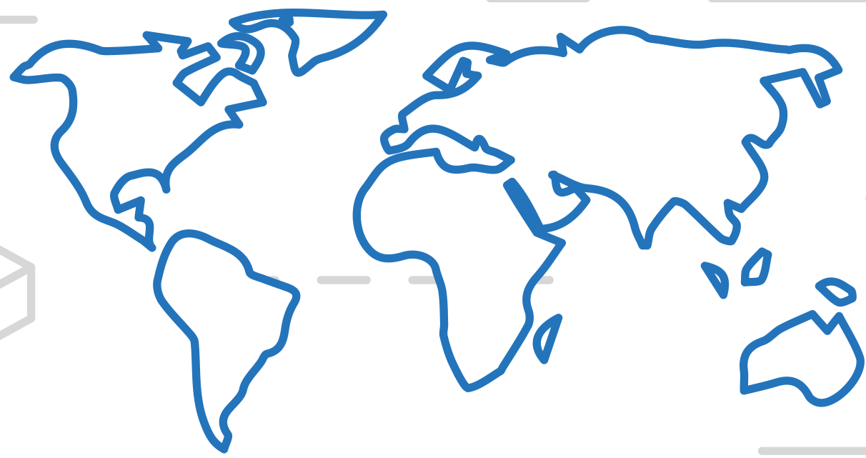
Azure Container Registry (ACR)
ACS Engine
Manage a Docker private registry as a first-class Azure resource
Azure Container Instances (ACI)
Azure Container Registry (ACR)
Open Service Broker API (OSBA)
Manage images for all types of containers
Use familiar, open-source Docker CLI tools
Azure Container Registry geo-replication
Release Automation Tools

Slide 48
ACS Engine
Containers as the App Packaging Format
Azure Container Instances (ACI)
Deploy to your preferred environment
Azure Kubernetes Service (AKS)
Azure Container Instances (ACI)
Azure Container Registry (ACR)
Azure clients: PS, CLI, Portal, SDK
Developer tools: VS, VS Code, VSTS
OSS clients: GitHub, Terraform, Draft, Helm, etc.
Azure Container Registry (ACR)
Service Fabric
App Service
Open Service Broker for Azure (OSBA)
Machine Learning
IoT
Release Automation Tools

Slide 49
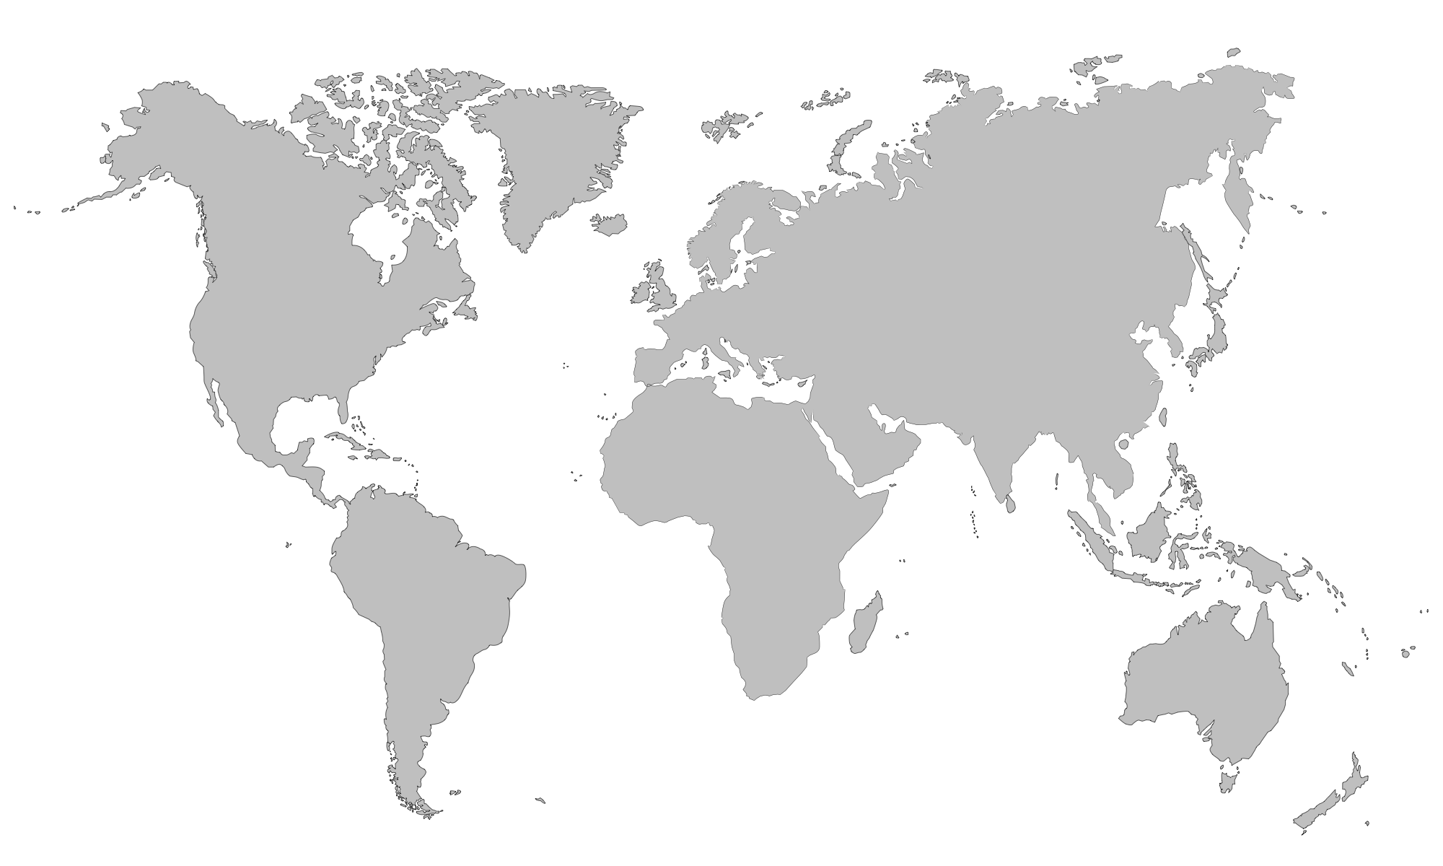
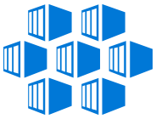
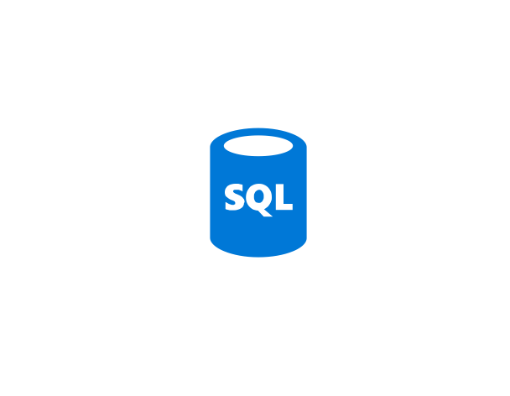



ACS Engine
ACR Geo-replication
ACR Geo-replication
Speeds up time to recovery
Improves performance of container-based deployments
Azure Container Instances (ACI)
Azure Container Registry (ACR)
Geo-replicate a single registry
All regions have a local replica
Geo-replicate a single registry
All regions have a local replica
West Europe
Canada Central
West US
East US
Open Service Broker for Azure (OSBA)
Push Built Images
docker push contoso.azurecr.io/web:1234
ACR Syncs Image Blobs
Regional Web Hooks fire for local deployments
Nodes Pull Images
docker pull contoso.azurecr.io/web:1234
Each registry is pulling from a local, network close, reliable registry
Release Automation Tools

Slide 50
Built-in security with ACR
ACS Engine
Azure Container Instances (ACI)
Azure Container Registry (ACR)
Authenticate using Azure Active Directory Identity
Integrated OS & Framework Patching
Secure images by default with quarantine pattern
Open Service Broker for Azure (OSBA)
Release Automation Tools

Slide 51
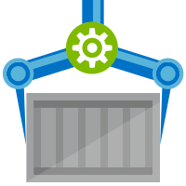
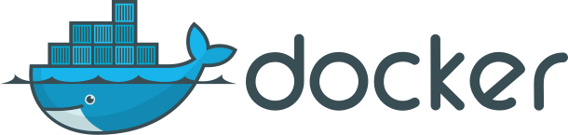
ACS Engine
ACR Tasks
Azure Container Instances (ACI)
Native Container Build Service in the cloud
Follows build semantics
docker build –t helloworld:v1 .
az acr build –t helloworld{{.Build.ID}} .
Trigger based builds (git commits, base image updates)
az acr build-task create –-image helloworld{{.Build.ID}}
--name myBuildTask
--registry jengademos
--context https://github.com/me/helloworld
--branch master
--git-access-token $PAT
Azure Container Registry (ACR)
Open Service Broker for Azure (OSBA)
Release Automation Tools

Slide 52
DevOps Practices Arrive
ACS Engine
Azure Container Instances (ACI)
1.
Business Need/ Use Cases
Product Owner
7.
Monitoring / Operations
Azure Monitor
Azure Container Registry (ACR)
DevOps+ Continuous Delivery Cycle
2.
Software Development Team
6.
Automated Deployment
Open Service Broker for Azure (OSBA)
3.
Software Check-in
5.
Automated Test Scripts
Release Automation Tools
4.
Automated Software Build

Slide 53
Why DevOps?
ACS Engine
The benefits
Azure Container Instances (ACI)
46x
more frequent deployments
5x
lower change failure rate
Azure Container Registry (ACR)
440x
faster deployments
440x
shorter lead times
Open Service Broker for Azure (OSBA)
Release Automation Tools

Slide 54
Release automation workflow
ACS Engine
New code directory
Create a code file
Draft creates a dockerfile and a Helm chart for service composition
Azure Container Instances (ACI)
New directory
Add a code file
Draft create
Azure Container Registry (ACR)
Yes
Does it work?
Git push
Draft commit
Draft up
No
Open Service Broker for Azure (OSBA)
Deploy code container chart
CI/CD
Release Automation Tools
Draft helps devs get running
Draft helps devs and operations iterate on containers and services
Artifacts push to cloud, controlled by CI/CD processes

Slide 55
Release automation workflow
ACS Engine
Once developers are up and running—or working on a service that is in a complex system—Draft ALSO helps devs ignore artifacts and focus on code
Azure Container Instances (ACI)
Get clone
Draft pack-reps
Draft create
Azure Container Registry (ACR)
Yes
Does it work?
Git push
Draft up
No
Open Service Broker for Azure (OSBA)
Debug
CI/CD
Release Automation Tools
Draft helps devs get running
Draft helps devs and operations iterate on containers and services
Artifacts push to cloud, controlled by CI/CD processes

Slide 56
Release automation workflow
ACS Engine
Create
Azure Container Instances (ACI)
Draft create
Have code?
No
New
Draft page
Azure Container Registry (ACR)
Yes
Builds image/config. to be deployed
Staged?
Yes
Code
Container
Configuration
Draft create or Draft create-pack (if specific artifacts exist)
Deploy image (AKS)
Deploy to staging
No
Push image
Canary deploy to production
CD: No staging
No
Testing good?
Move to dev cluster
Change
Code
Container
Configuration
Open Service Broker for Azure (OSBA)
Actual development, Draft up/connect iteration
The building process: Brigade, Jenkins, VS TS
Build container
Telemetry successful?
Rollback
Yes
No
2 factor authentication
Push to production as canary
Release Automation Tools
Yes
Git push
Pull code
Rollout
Code/artifacts ready

Slide 57

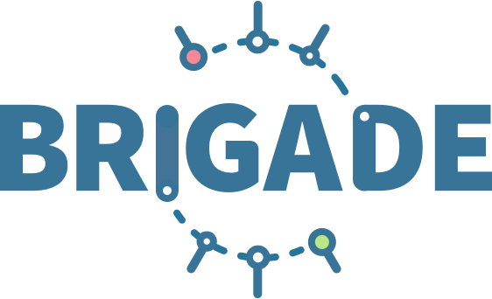

Release automation tools
ACS Engine
Simplifying the Kubernetes experience
Azure Container Instances (ACI)
Azure Container Registry (ACR)
Streamlined Kubernetes development
The package manager for Kubernetes
Event-driven scripting for Kubernetes
Open Service Broker for Azure (OSBA)
Release Automation Tools

Slide 58
Helm
ACS Engine
The best way to find, share, and use software built for Kubernetes
Azure Container Instances (ACI)
Azure Container Registry (ACR)
Manage complexity
Charts can describe complex apps; provide repeatable app installs, and serve as a single point of authority
Easy updates
Take the pain out of updates with in-place upgrades and custom hooks
Simple sharing
Charts are easy to version, share, and host on public or private servers
Rollbacks
Use helm rollback to roll back to an older version of a release with ease
Open Service Broker for Azure (OSBA)
Release Automation Tools

Slide 59

Helm
ACS Engine
Helm Charts helps you define, install, and upgrade even the most complex Kubernetes application
Azure Container Instances (ACI)
services
ci
db
Azure Container Registry (ACR)
load balancer
custom
…
Chart.yml
Open Service Broker for Azure (OSBA)
Release Automation Tools

Slide 60
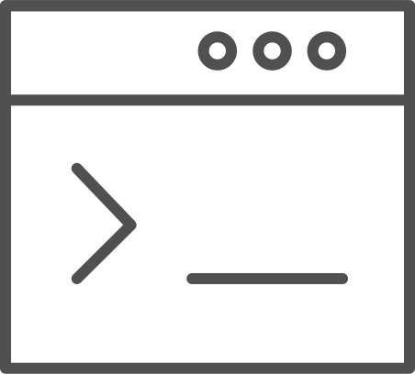
Draft
ACS Engine
Simple app development and deployment – into any Kubernetes cluster
Azure Container Instances (ACI)
Azure Container Registry (ACR)
Simplified development
Using two simple commands, developers can now begin hacking on container-based applications without requiring Docker or even installing Kubernetes themselves
Language support
Draft detects which language your app is written in, and then uses packs to generate a Dockerfile and Helm Chart with the best practices for that language
Open Service Broker for Azure (OSBA)
Release Automation Tools

Slide 61

Draft
ACS Engine
Draft in action
Azure Container Instances (ACI)
Azure Container Registry (ACR)
Open Service Broker for Azure (OSBA)
Release Automation Tools

Slide 62
Brigade
ACS Engine
Run scriptable, automated tasks in the cloud — as part of your Kubernetes cluster
Azure Container Instances (ACI)
Azure Container Registry (ACR)
Simple, powerful pipes
Each project gets a brigade.js config file, which is where you can write dynamic, interwoven pipelines and tasks for your Kubernetes cluster
Runs inside your cluster
By running Brigade as a service inside your Kubernetes cluster, you can harness the power of millions of available Docker images
Open Service Broker for Azure (OSBA)
Release Automation Tools

Slide 63
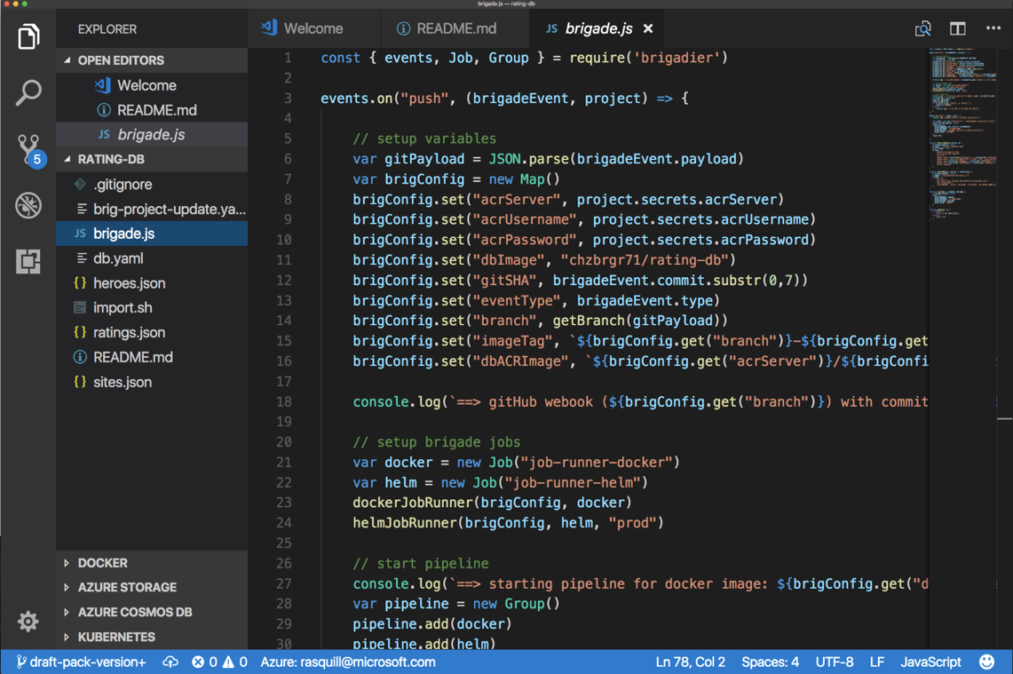
Brigade
ACS Engine
Brigade in action
Azure Container Instances (ACI)
Azure Container Registry (ACR)
Open Service Broker for Azure (OSBA)
Release Automation Tools

Slide 64
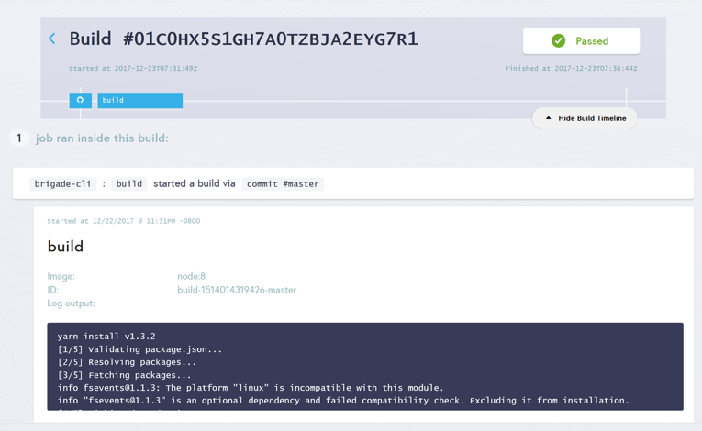
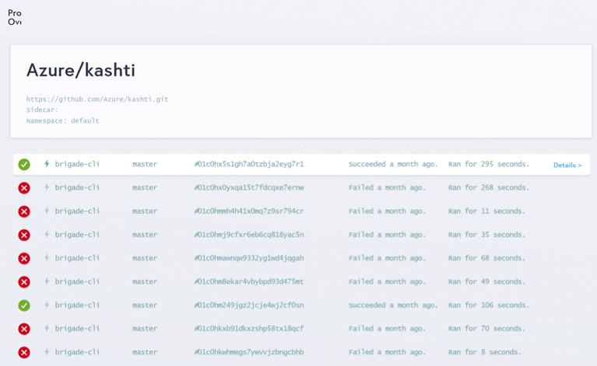
Brigade UI
ACS Engine
Dashboards for Brigade pipelines
Azure Container Instances (ACI)
Azure Container Registry (ACR)
Open Service Broker for Azure (OSBA)
Release Automation Tools
Builds dashboard
Events log

Slide 65
Resources
Introduction
Top scenarios
Open source culture
Product deep dive
Azure Kubernetes Service Overview
Customer stories
Resources

Slide 66
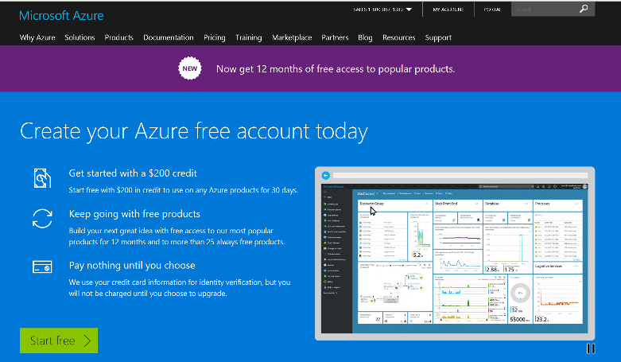
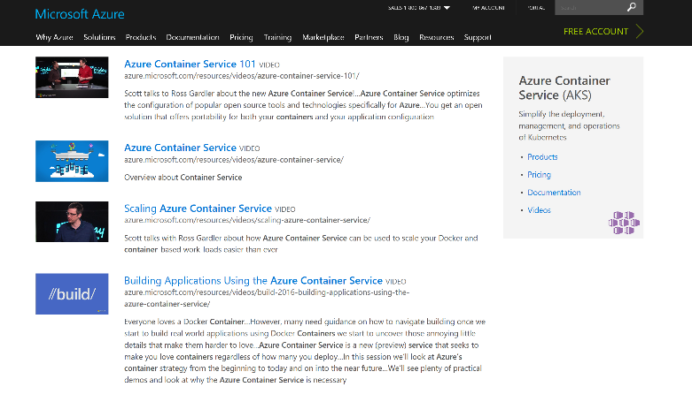
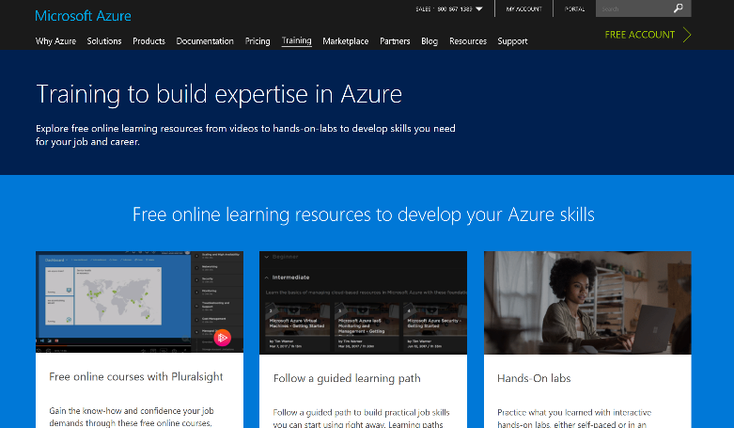
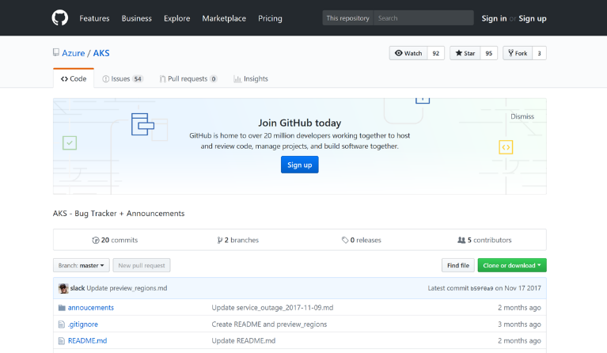
AKS resources
Azure Kubernetes Service (AKS)
Containers on Azure pitch deck
Smart Hotel 360 Demo
Documentation resources
Ebook for distributed systems
Distributed system HoL
AKS HoL
Sign up for a free Azure account
Check out the Azure container videos page
Hone your skills with Azure training
Get the code from GitHub

Slide 67
Connect with us
Core team
PM: Gabe Monroy, @gabrtv
PM: Sean McKenna
PM: Jason Hansen
PMM: Stella Lin
CDA: Bryan Liston
Community
Brendan Burns, @brendandburns
Michelle Noorali
Partner team
Morgan Pettis
Leon Jones
Dan Sandlin

Slide 68
Microservices

Slide 69
microservices ≠ containers
microservices is an architectural design approach
containers are an implementation detail that often helps

Slide 70
Microservices Benefits
Independent deployments
Enables continuous delivery
No downtime upgrades
Improved scale and resource utilization per service
Fault isolation
Security isolation
Services can be distributed across multiple servers or environments
Multiple languages / diversity
Smaller, focused teams
Code can be organized around business capabilities
Autonomous developer teams

Slide 71
Microservices – The Hard Part
Deployment is complex
Testing is difficult
Debugging is difficult
Monitoring/Logging is difficult
New service versions must support old/new API contracts
Distributed databases make transactions hard
Cluster and orchestration tools overhead
Distributed services adds more network communication
Increased network hops
Requires failure/recovery code
Need service discovery solution
Advanced DevOps capability: short-term pain for long-term gain

Slide 72
12-Factor Apps
http://12factor.net
Notes:
Explain the benefits of 12 factor apps without walking through all of them.
Recommended guidelines for good microservices apps

Slide 73
12-Factor Apps (1-5)
Single root repo; don’t share code with another app
Deploy dependent libs with app
No config in code; read from environment vars
Handle unresponsive app dependencies robustly
Strictly separate build, release, & run steps
Build: Builds a version of the code repo & gathers dependencies
Release: Combines build with config ReleaseId (immutable)
Run: Runs app in execution environment
Notes:
Single root repo; don’t share code with another app
Deploy dependent libs with app
No config in code; read from environment vars
Handle unresponsive app dependencies robustly
Strictly separate build, release, & run steps
Build: Builds a version of the code repo & gathers dependencies
Release: Combines build with config → ReleaseId (immutable)
Run: Runs app in execution environment

Slide 74
12-Factor Apps (6-12)
App executes as 1+ stateless process & shares nothing
App listens on ports; avoid using (web) host
Use processes for isolation; multiple for concurrency
Processes can crash/be killed quickly & start fast
Keep dev, staging, & prod environments similar
Log to stdout (dev=console; prod=file & archived)
Deploy & run admin tasks (scripts) as processes
Notes:
App executes as 1+ stateless process & shares nothing
App listens on ports; avoid using (web) host
Use processes for isolation; multiple for concurrency
Processes can crash/be killed quickly & start fast
Keep dev, staging, & prod environments similar
Log to stdout (dev=console; prod=file & archived)
Deploy & run admin tasks (scripts) as processes

